Slide 1
Step 1: Remove already installed container engine.
yum remove docker docker-client docker-client-latest docker-common docker-latest docker-latest-logrotate docker-logrotate docker-engine podman buildah -y
Notes:
Before installing the Docker packages, We should remove other packages such as RunC, Podman and so on. This is our Step1. “click”
After that, In Step 2, we will be going to install the YUM-Utils package. “Click”

Slide 2
Execute below commands in order to install the Docker packages
yum remove docker docker-client docker-client-latest docker-common docker-latest docker-latest-logrotate docker-logrotate docker-engine podman buildah -y
Step 2: yum install -y yum-utils
Why we need to install the yum-utils?
yum-utils is a collection of tools and programs for managing yum repositories, installing debug packages, source packages, extended information from repositories and administration.
Notes:
yum-utils is a collection of tools and programs for managing yum repositories, installing debug packages, source packages, extended information from repositories and administration.
As we are using yum command often, so I am installing this package. “click”

Slide 3
Execute below commands in order to install the Docker packages
yum remove docker docker-client docker-client-latest docker-common docker-latest docker-latest-logrotate docker-logrotate docker-engine podman buildah -y
yum install -y yum-utils
Step 3: Need to add the repo file for Docker packages
yum-config-manager --add-repo https://download.docker.com/linux/centos/docker-ce.repo
yum install containerd.io docker-ce docker-ce-cli -y
Notes:
In Step 3, Need to add the repo file for Docker packages, this is the command.
In Step 4, we install the Docker packages.
containerd.io , docker-ce and docker-ce-cli

Slide 4
containerd is available as a daemon for Linux and Windows. It manages the complete container lifecycle of its host system, from image transfer from one place to anther and storage to container execution (fetch the file from the storage if container required) and supervision to low-level storage to network attachments (data will flow from where?) and beyond.
Containerd uses the OS kernel feature such as Namespace and Cgroups.
cgroups (abbreviated from control groups) is a Linux kernel feature that limits, accounts for, and isolates the resource usage (CPU, memory, disk I/O, network, etc.) of a collection of processes.
A namespace wraps a global system resource in an abstraction that makes it appear to the processes within the namespace that they have their own isolated instance of the global resource.
Changes to the global resource are visible to other processes that are members of the namespace but are invisible to other processes.
Cgroups = It limits how much you can use the memory, CPU, block I/O, network.
Namespaces = It limits what you can see (and therefore you can use)

Slide 5
containerd is available as a daemon for Linux and Windows. It manages the complete container lifecycle of its host system, from image transfer from one place to anther and storage to container execution (fetch the file from the storage if container required) and supervision to low-level storage to network attachments (data will flow from where?) and beyond.
Containerd uses the OS kernel feature such as Namespace and Cgroups.
Docker-ce-cli: It provide command line interface for docker engine, community edition
the open-source application container engine.
Docker containers are both hardware-agnostic and platform-agnostic.
In an IT context, agnosticism refers to anything that is designed to be compatible across most common systems.
This means they can run anywhere, from your laptop to the largest cloud compute instance and everything in between - and they don't require you to use a particular language, framework or packaging system.
Docker is a product for you to build, ship and run any application as a lightweight container.

Slide 6
docker run …. → This command comes with docker-ce-cli package
When we execute any command, docker-ce will call containerd process.
Containerd will call the runc

Slide 7
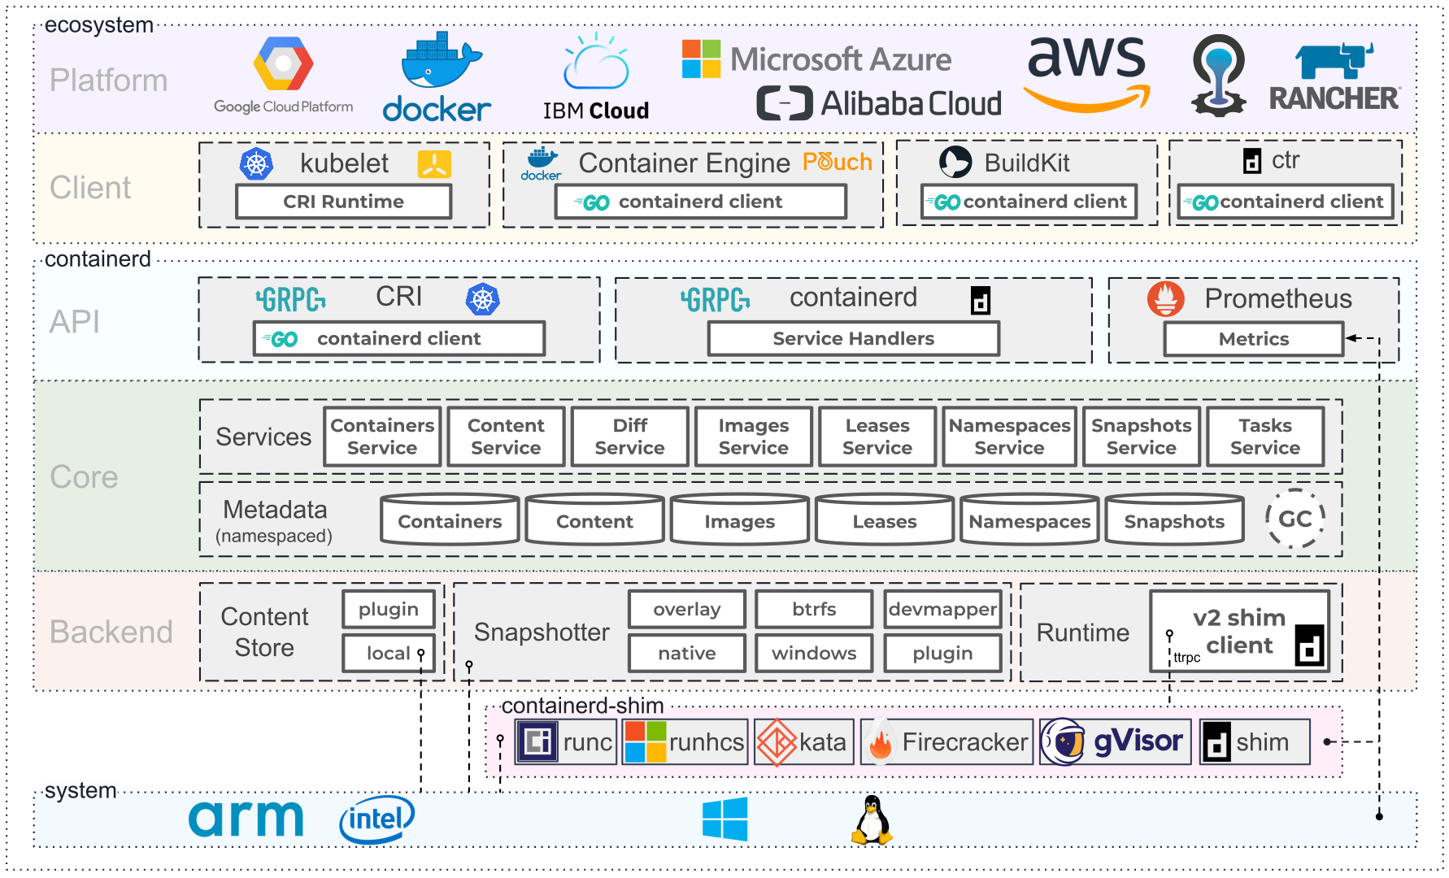

Slide 9
Command Line
docker
--help

Slide 10
Management Command
Management Commands:
app* Docker App (Docker Inc., v0.9.1-beta3)
builder Manage builds
buildx* Build with BuildKit (Docker Inc., v0.6.1-docker)
config Manage Docker configs
container Manage containers
context Manage contexts
image Manage images
manifest Manage Docker image manifests and manifest lists
network Manage networks
node Manage Swarm nodes
plugin Manage plugins
scan* Docker Scan (Docker Inc., v0.8.0)
secret Manage Docker secrets
service Manage services
stack Manage Docker stacks
swarm Manage Swarm
system Manage Docker
trust Manage trust on Docker images
volume Manage volumes
Docker
Command
Commands:
attach Attach local standard input, output, and error streams to a running container
build Build an image from a Dockerfile
commit Create a new image from a container's changes
cp Copy files/folders between a container and the local filesystem
create Create a new container
diff Inspect changes to files or directories on a container's filesystem
events Get real time events from the server
exec Run a command in a running container
export Export a container's filesystem as a tar archive
history Show the history of an image
images List images
import Import the contents from a tarball to create a filesystem image
info Display system-wide information
inspect Return low-level information on Docker objects
kill Kill one or more running containers
load Load an image from a tar archive or STDIN
login Log in to a Docker registry
logout Log out from a Docker registry
logs Fetch the logs of a container

Slide 11
Management Command
Management Commands:
app* Docker App (Docker Inc., v0.9.1-beta3)
builder Manage builds
buildx* Build with BuildKit (Docker Inc., v0.6.1-docker)
config Manage Docker configs
container Manage containers
context Manage contexts
image Manage images
manifest Manage Docker image manifests and manifest lists
network Manage networks
node Manage Swarm nodes
plugin Manage plugins
scan* Docker Scan (Docker Inc., v0.8.0)
secret Manage Docker secrets
service Manage services
stack Manage Docker stacks
swarm Manage Swarm
system Manage Docker
trust Manage trust on Docker images
volume Manage volumes
Docker

Slide 12
Management Command
Management Commands:
app* Docker App (Docker Inc., v0.9.1-beta3)
builder Manage builds
buildx* Build with BuildKit (Docker Inc., v0.6.1-docker)
config Manage Docker configs
container Manage containers
context Manage contexts
image Manage images
manifest Manage Docker image manifests and manifest lists
network Manage networks
node Manage Swarm nodes
plugin Manage plugins
scan* Docker Scan (Docker Inc., v0.8.0)
secret Manage Docker secrets
service Manage services
stack Manage Docker stacks
swarm Manage Swarm
system Manage Docker
trust Manage trust on Docker images
volume Manage volumes
Docker

Slide 13
Command Line
[root@ ~]# docker container --help
Usage: docker container COMMAND
Manage containers
Commands:
attach Attach local standard input, output, and error streams to a running container
commit Create a new image from a container's changes
cp Copy files/folders between a container and the local filesystem
create Create a new container
diff Inspect changes to files or directories on a container's filesystem
exec Run a command in a running container
export Export a container's filesystem as a tar archive
inspect Display detailed information on one or more containers
kill Kill one or more running containers
logs Fetch the logs of a container
ls List containers
pause Pause all processes within one or more containers
port List port mappings or a specific mapping for the container
prune Remove all stopped containers
rename Rename a container
restart Restart one or more containers
rm Remove one or more containers
run Run a command in a new container.
docker
container
--help

Slide 14
Create a new Container
create Create a new container. (Only Create)
run Run a command in a new container. (Create + Start)
start Start one or more stopped containers
stop Stop one or more running containers
pause Pause all processes within one or more containers
unpause Unpause all processes within one or more containers

